Slide 1
Android Development
Akshath Jain
Mobile & IoT — Spring 2019

Slide 2











Slide 3
https://developer.android.com/studio/

Slide 4
Paradigm

Slide 5


Paradigm
App Components
Activity
Service
Broadcast receiver
Content Provider
User interaction
Background processing
System-wide communication
Shared System Resources
Viewing email Watching videos Uploading images
Playing music Fetching data Syncing data
Screen turned oﬀ Low battery warning Notifications & Alarms
Accessing contacts
Retrieving calendar events

Slide 6

Activity
Lifecycle

Slide 7

Lifecycle
onCreate()
onStart()
onRestart()
onResume()
App Process Killed
Activity Running
onPause()
onStop()
onDestroy()

Slide 8
Considerations

Slide 9

Software Fragmentation
Ice Cream Sandwich
Jelly Bean
KitKat
Gingerbread Pie
Oreo
Lollipop
Nougat
Marshmallow

Slide 10
Hardware Fragmentation
Huawei
Xiaomi
Oppo
Motorola LG
Vivo Lenovo Sony Amlogic HTC
Tecno Alcatel OnePlus
Samsung

Slide 11
Hello World

Slide 12
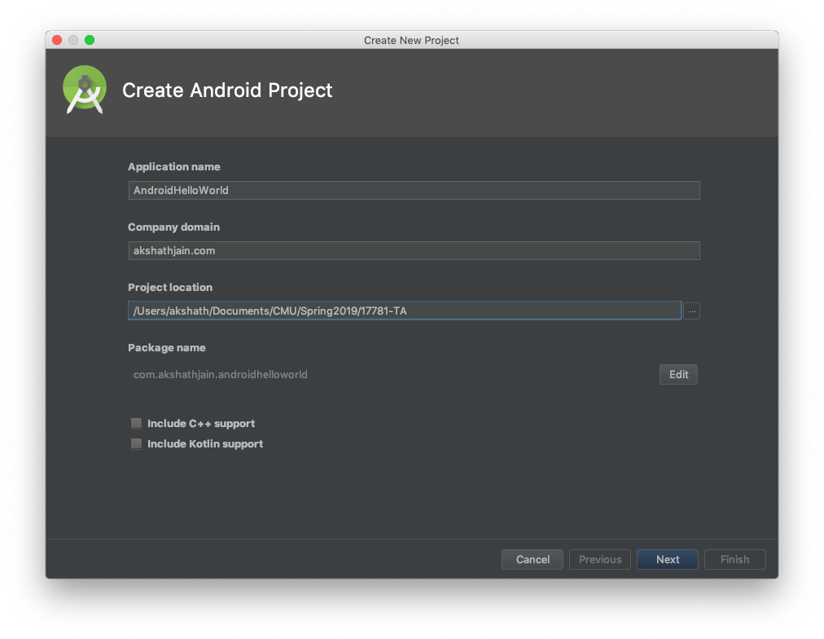

Slide 13
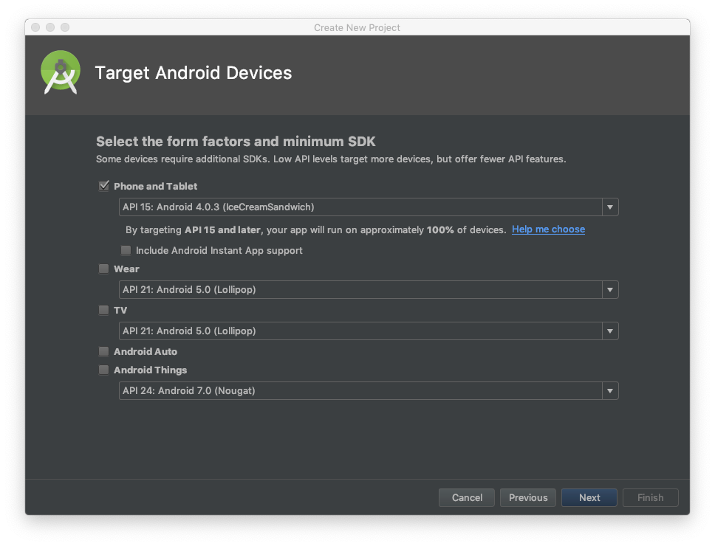

Slide 14
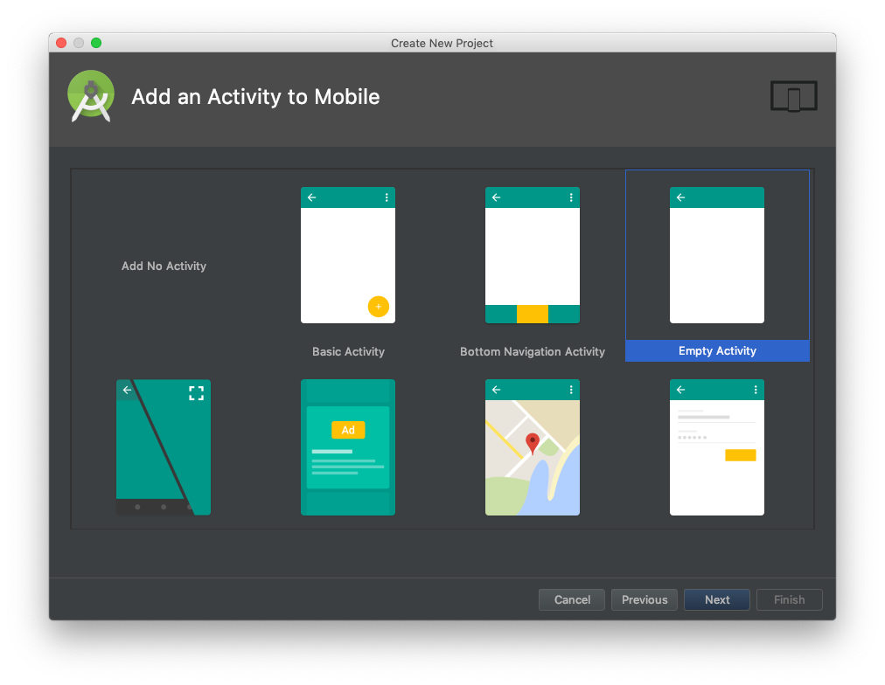

Slide 15
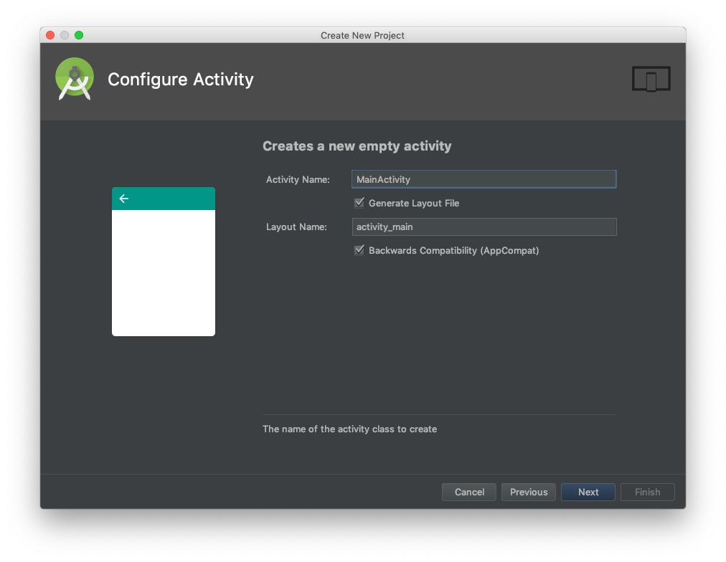

Slide 16
Code
<?xml version="1.0" encoding="utf-8"?>
<RelativeLayout xmlns:android="http://schemas.android.com/apk/res/android" xmlns:app="http://schemas.android.com/apk/res-auto" xmlns:tools="http://schemas.android.com/tools" android:layout_width="match_parent" android:layout_height="match_parent"
tools:context=".MainActivity"
android:layout_centerHorizontal="true" android:layout_centerVertical="true">
app
├── manifests/
├── java/
├── res/
│ ├── drawable/
│ ├── layout/
│
│
└──
│ └── activity_main.xml
└── values/
<TextView
android:layout_width="wrap_content" android:layout_height="wrap_content" android:text="Hello World!" android:layout_centerVertical="true" android:layout_centerHorizontal="true" />
</RelativeLayout>

Slide 17
Code
app
├── manifests/
├── java/
package com.akshathjain.androidhelloworld;
│ └── MainActivity.java
import android.support.v7.app.AppCompatActivity; import android.os.Bundle;
└── res/
public class MainActivity extends AppCompatActivity {
@Override
protected void onCreate(Bundle savedInstanceState) { super.onCreate(savedInstanceState); setContentView(R.layout.activity_main);
}
}

Slide 18

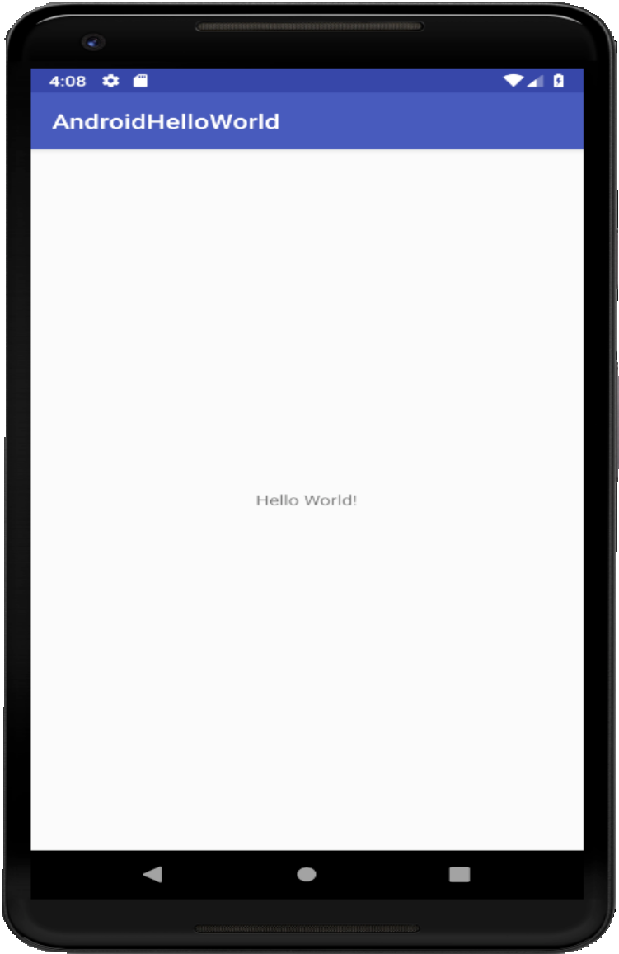
Emulation

Slide 19
Cross Platform Frameworks
Akshath Jain
Mobile & IoT — Spring 2019

Slide 20













Slide 21
lutter
Akshath Jain
Mobile & IoT / Crash Course 2019

Slide 22



Slide 23












Slide 24
Fast Native Efficient

Slide 25






Slide 26
https://flutter.io/docs/get-started/install
https://akshathjain.com/FlutterWorkshop

Slide 27
Paradigm

Slide 28
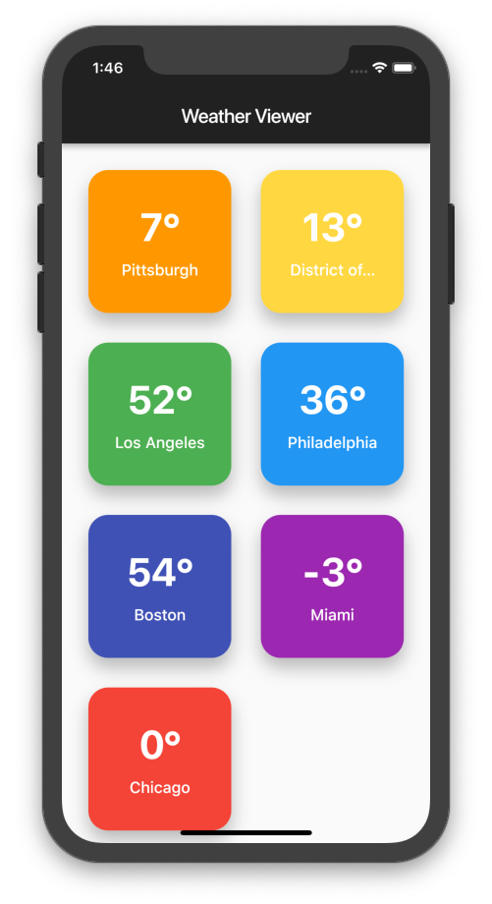
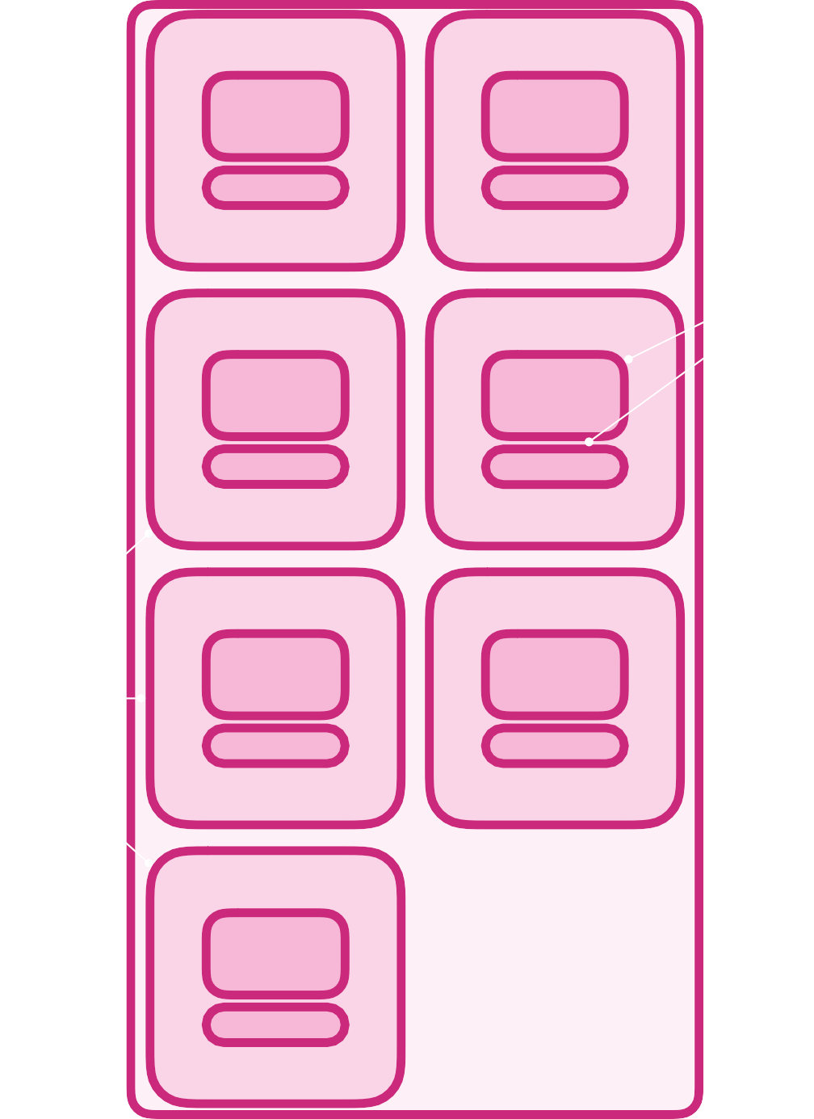
Paradigm
AppBar
GridView
Text
Card

Slide 29





Paradigm
Widget
StatelessWidget
StatefulWidget
AlertDialog
Card
Drawer
CheckBox
Form
Image
Icon
Text
Title
AppBar
BottomNavigationBar

Slide 30
StatefulWidget
Lifecycle

Slide 31

Lifecycle
createState()
initState()
build()
setState()
dispose()

Slide 32
Hello World

Slide 33
Setup
flutter create helloworld
cd helloworld

Slide 34
Code
import 'package:flutter/material.dart';
void main() => runApp(MyApp());
class MyApp extends StatelessWidget { @override
Widget build(BuildContext context) {
return MaterialApp( title: "Hello World", home: HomePage(),
);
}
}
helloworld
├── android/
├── ios/
├── lib/
│ └── main.dart
├── test/
class HomePage extends StatefulWidget { HomePage({Key key}) : super(key: key);
└── pubspec.yaml
@override
_HomePageState createState() => _HomePageState();
}
class _HomePageState extends State<HomePage> { @override
Widget build(BuildContext context){
return Scaffold( appBar: AppBar(
title: Text("Flutter Demo"),
),
body: Center(
child: Text("Hello World"),
),
);
}
}

Slide 35
Execution
➜ | flutter | emulators | —-launch | <emulator_id>
➜ | flutter | run

Slide 36
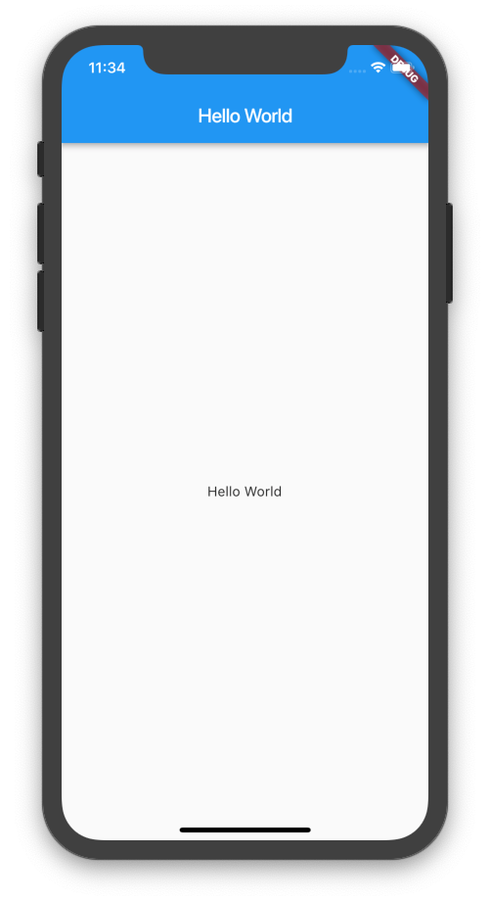

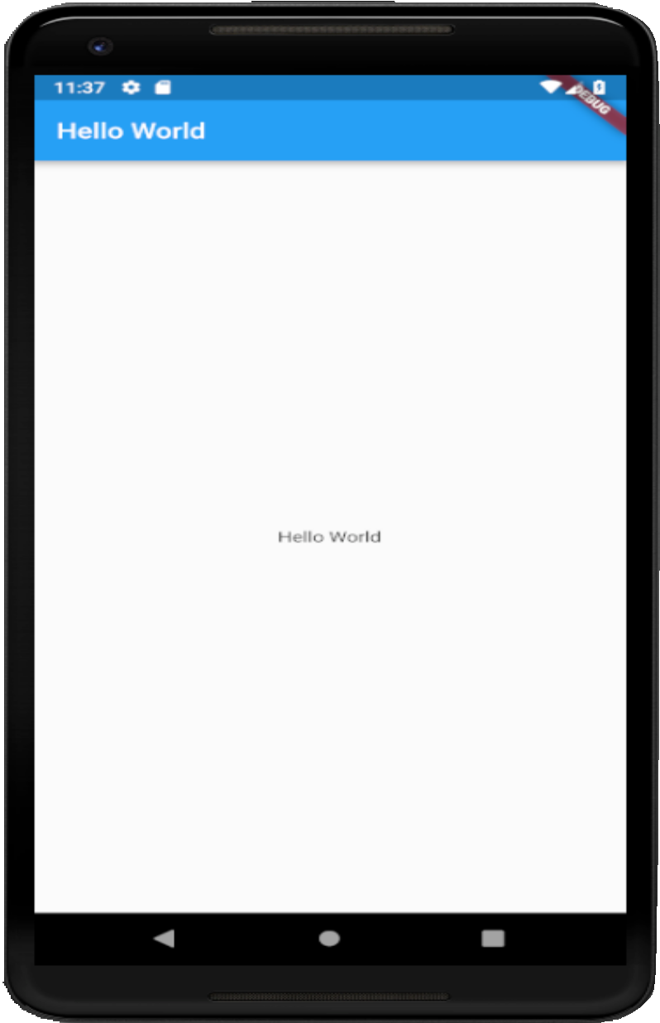
Emulation

Slide 37
Live Demo

Slide 38
Live Demo
git clone https://github.com/akshathjain/FlutterWorkshop
cd FlutterWorkshop/weatherviewer_boilerplate

Slide 39
Fin.

